Slide 1


Integracion Continua en SharePoint con Team Services y PnP
#spsbcn
Luis Mañez
Notes:
Start session with 3 browsers: SP site collection, VSTS 2 times, GitHub pnp template demo

Slide 2












Thanks to our Sponsors
Gold
Silver
Bronze
Raffle
Organized by
Notes:
Use this as the first slide in your slide deck

Slide 3

Luis Mañez
SharePoint / Cloud Solutions architect
ClearPeople LTD
http://geeks.ms/lmanez/
https://github.com/luismanez
@luismanez
SharePoint and Cloud solutions architect en ClearPeople. Cerca de 15 años trabajando con tecnologías Microsoft. SharePoint MCPD y Certified specialist in Developing Azure. OfficeDev PnP Key contributor.
Notes:
Template may be modified but please keep the title and the sponsor slide.
Twitter hashtag: #spsbcn for all sessions

Slide 4
Rapida introduccion al PnP
Entornos en proyectos SharePoint Online
Definiendo la Build de VSTS para CI
Trucos para agilizar el desarrollo
Agenda
Notes:
After agenda: who’s working with SP Online / VSTS / PnP ???

Slide 5

Demo Time!
Notes:
Show empty SP Site collection (home + site contents)
Jump to VSTS Build
Check SP url on build variables
Queue the build

Slide 6
Rápida introducción al programa PnP
Iniciativa de gente de Microsoft y reconocidos MVPs
Establece buenas prácticas para desarrollo en SharePoint Online
http://dev.office.com
Diferentes proyectos en GitHub con diferentes utilidades
Destacan:
PnP Core: https://github.com/OfficeDev/PnP-Sites-Core
PnP JavaScript Core: https://github.com/OfficeDev/PnP-JS-Core
PnP Provisioning Schema: https://github.com/OfficeDev/PnP-Provisioning-Schema
PnP PowerShell: https://github.com/OfficeDev/PnP-PowerShell
PnP Samples: https://github.com/OfficeDev/PnP

Slide 7


Entornos en proyectos SharePoint Online
Development - Office 365 E3
https://clientdev.sharepoint.com
Test (QA) - Office 365 E3
https://clientqa.sharepoint.com
Production
https://client.sharepoint.com
Site Collection
ProductDev 1
/sites/dev1news
Site Collection
ProductDev 2
/sites/dev2news
https://clientqa.sharepoint.com/sites/news
https://clientqa.sharepoint.com/sites/locations
Site Collection
ProductDev 1
/sites/dev1locations
Site Collection
ProductDev 2
/sites/dev2locations
https://clientqa.sharepoint.com/sites/search
Visitor user
Contributor user
Admin user
Demo data
Notes:
On premises story
New SP Online dev tenant: same license for all devs

Slide 8
Demo Time!
Definiendo la Build de VSTS para CI
Notes:
Comentario rapido sobre Gulp
Rapido vistazo al proyecto demo
Definicion de la Build: Agent options
$(Build.Repository.LocalPath)\SPSBcn.GulpAndPnp.DeployTool\bin\Release\SPSBcn.GulpAndPnp.DeployTool.exe
$(SharePointUrl) $(SharePointUser) $(SharePointPassword) $(Build.Repository.LocalPath)\SPSBcn.GulpAndPnp.Package\dist\src\pnp\ProvisioningTemplate.Package.xml
Ejecucion de la Build
Check results of first field queued at the beginning of the session

Slide 9
Bonus track!

Slide 10
Trucos para agilizar el desarrollo en SP Online
Organiza tus assets como lo hace SharePoint
Excluye lo que no necesites de tu Source control system
Fichero de configuración por entorno y developer
Independiza las tareas de Gulp
Valida tu JavaScript con jshint
Utiliza SASS (scss) para tus hojas de estilo
Minimiza tus ficheros JS y CSS
Utiliza sourcemaps en tus JS solo en desarrollo
Usa xinclude para conformar la plantilla PnP
Sincroniza tus updates a SharePoint en cada “Save file”

Slide 11
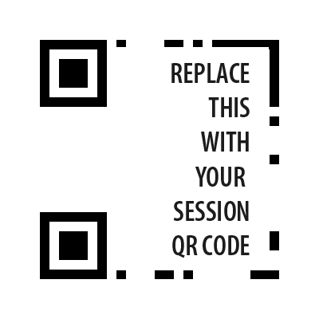
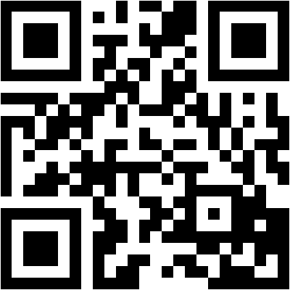
Thank you!
Questions?
Live Ratings
bit.ly/2deMiX3

